Slide 1

TriOptika
Optimizing Vision One Eye at a TIme

Slide 2
Who are we
Optimization
global tool
Business Analytics and Intelligence

Slide 3
Built
Image Manipulation
Processing
CSS
Python
Neural Network – RNN – Impact on Stock Market
API
OpenWeatherMap
NASA
Core Website
HTML5
JavaScript
BootStrap
CSS3
Illustrator

Slide 4
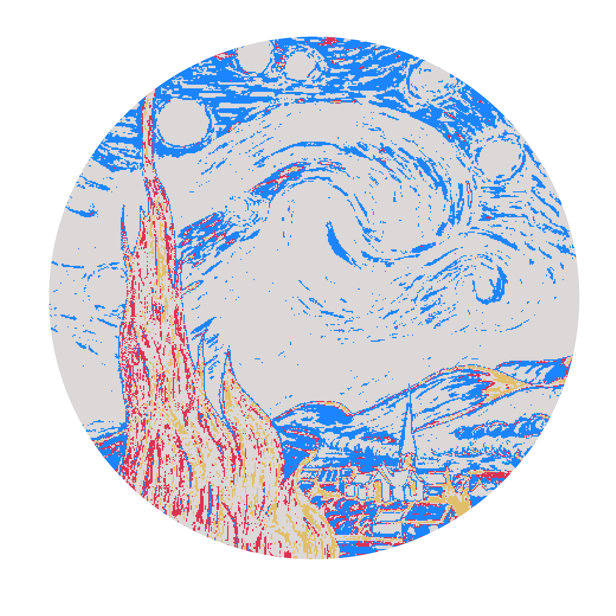

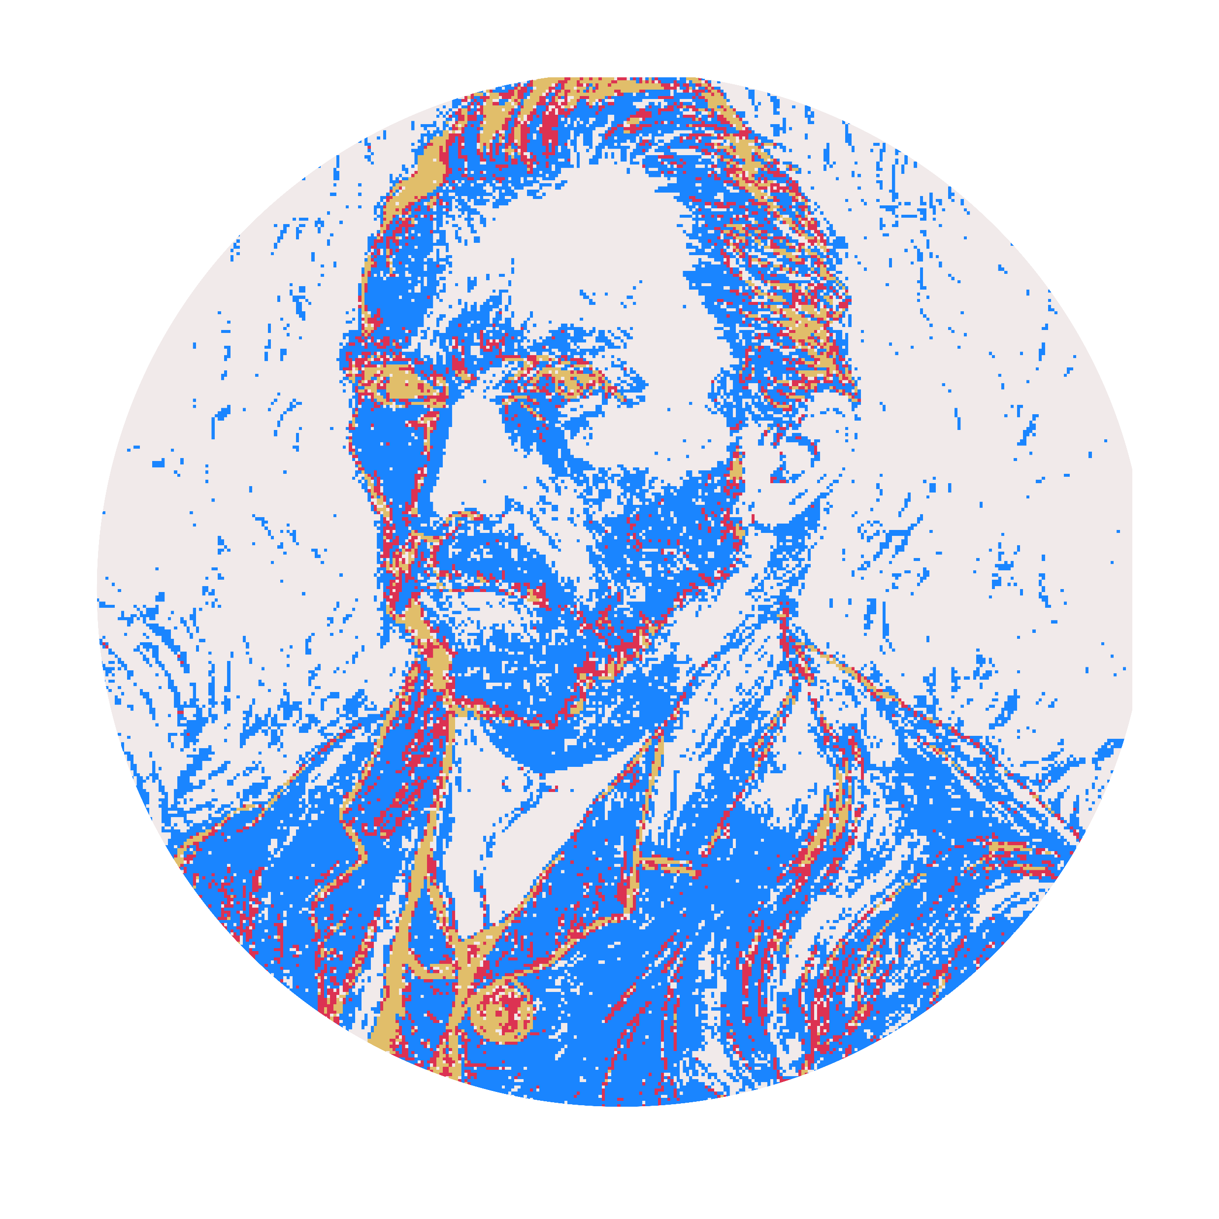

Slide 5
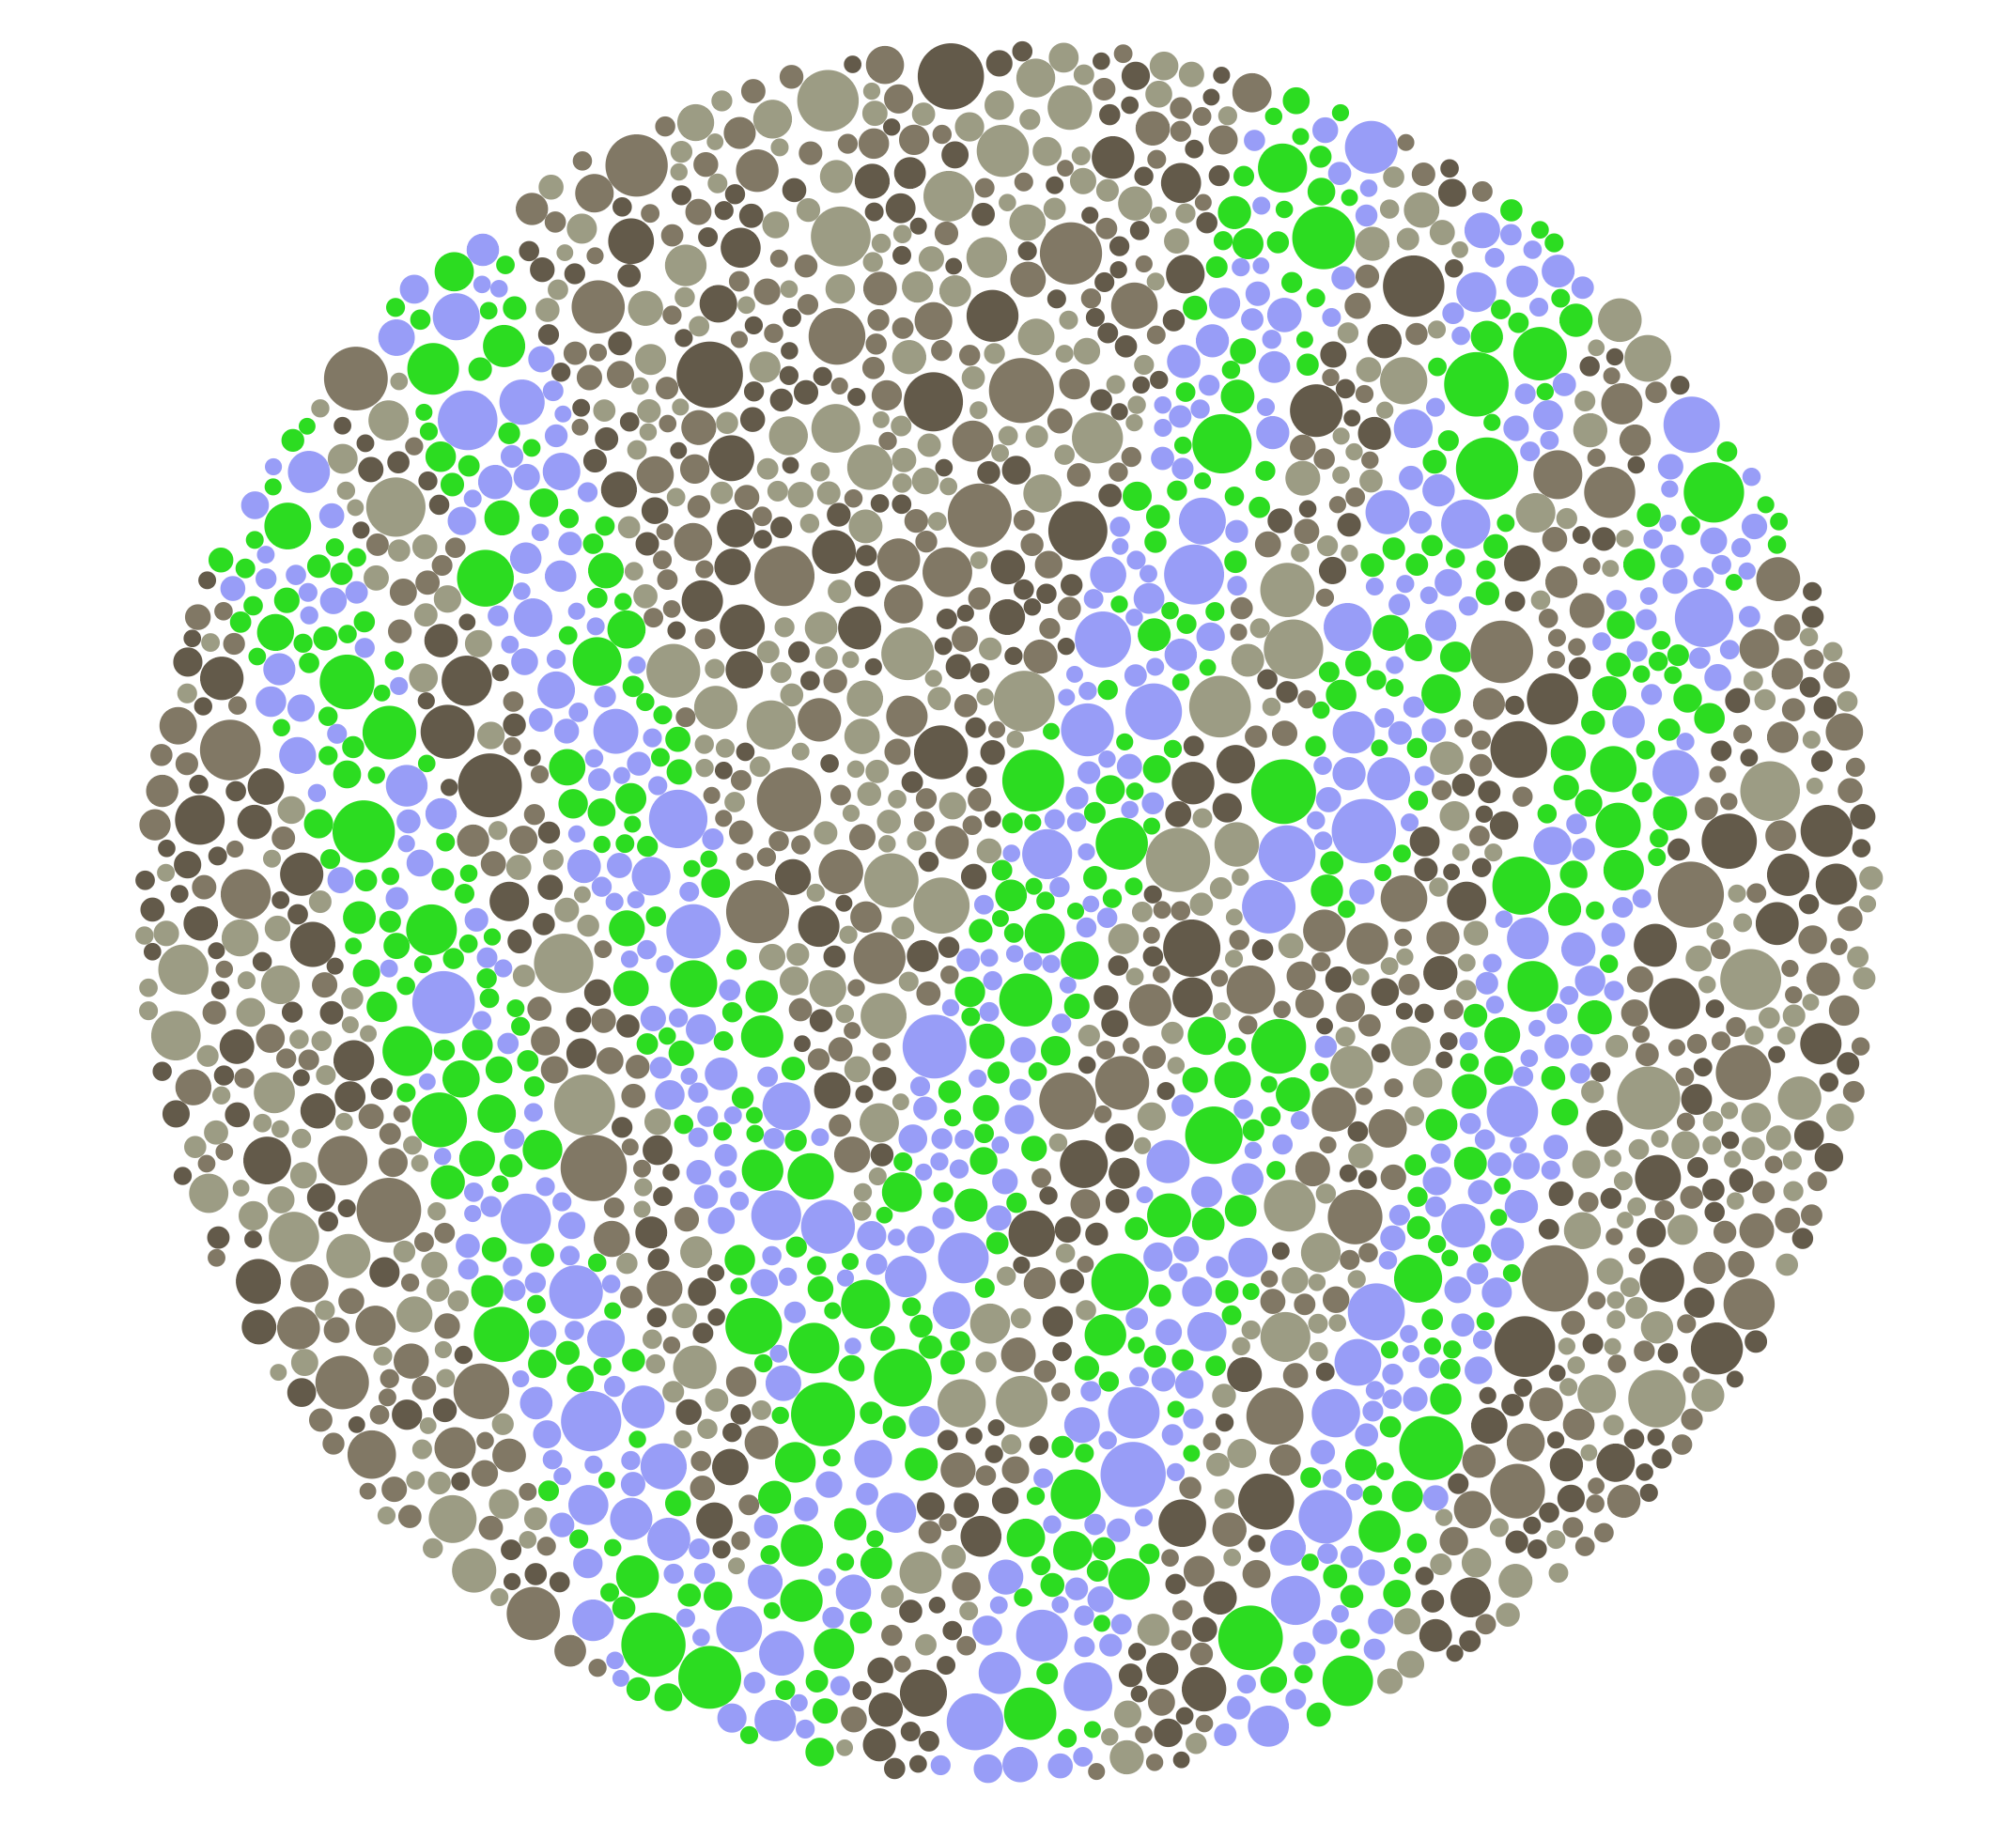
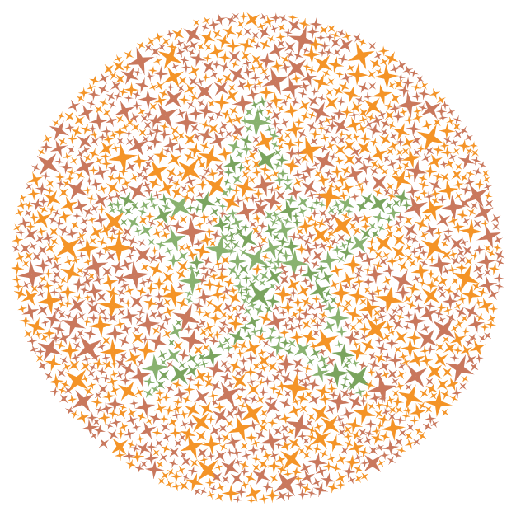
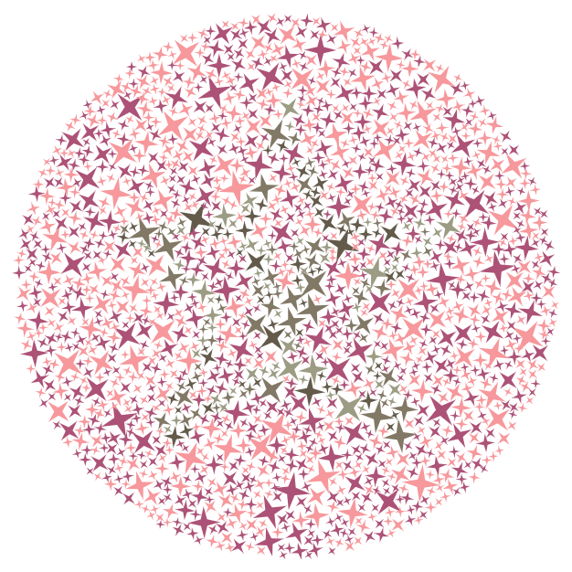
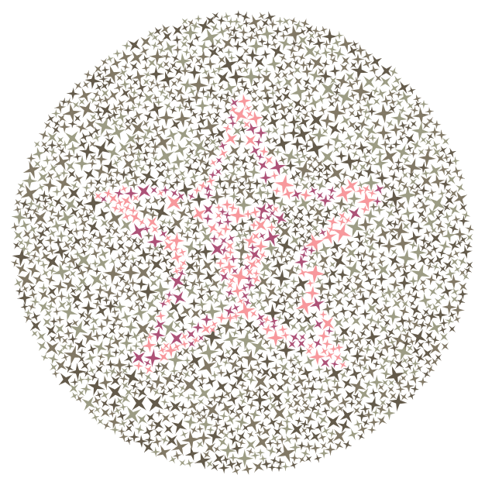

Slide 6
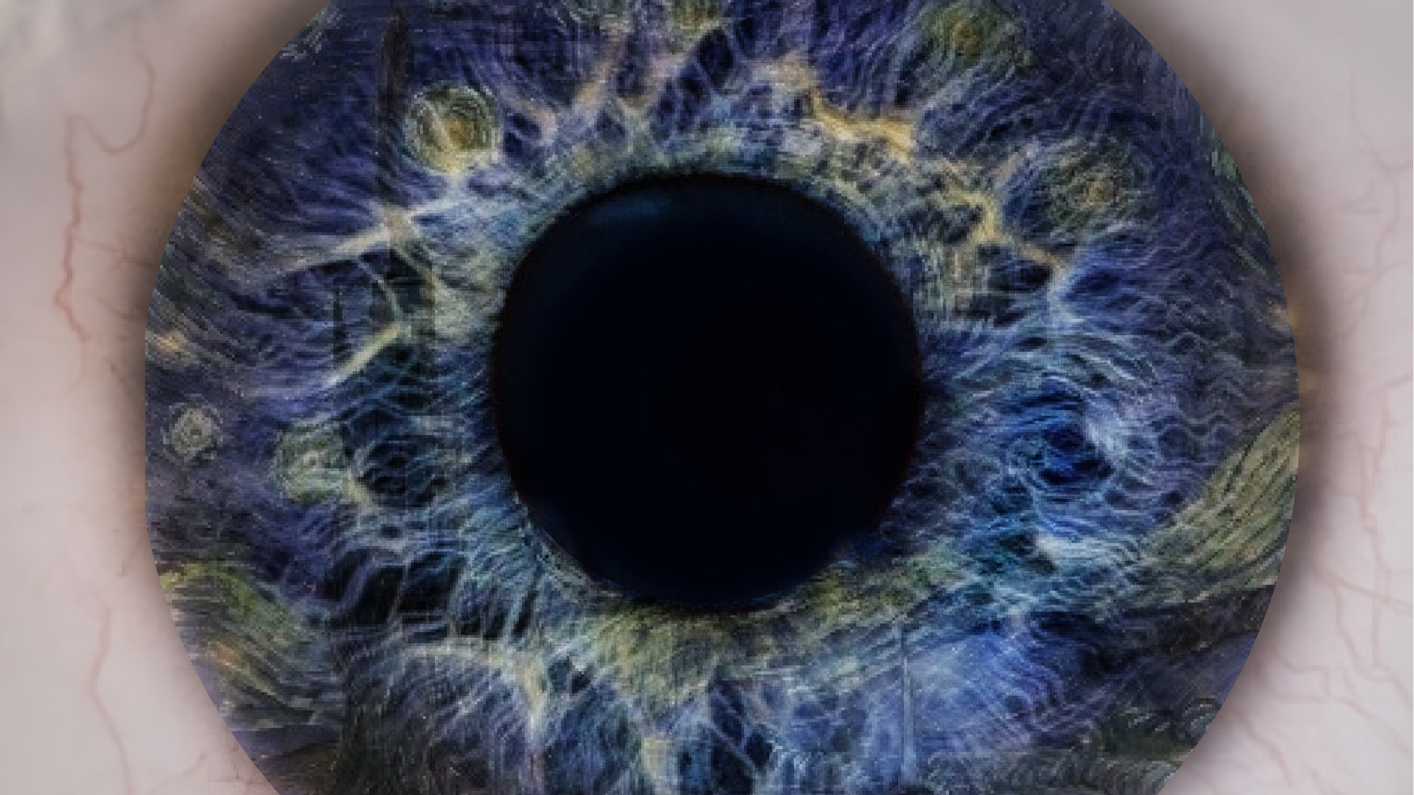

Slide 7
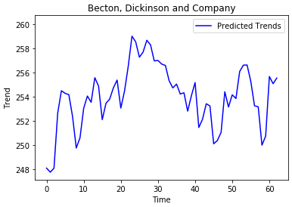
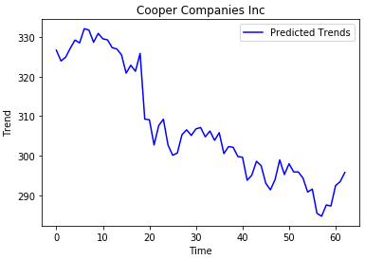
Stock Influence

